Slide 1
MC-sorter for Gray-coded values final project – Hardware Continues Metastability (8386101) Winter, 2024
Submitted by
Itay Roiz & Itay Goldberg

Slide 2
Parallel Prefix Computation
A hardware algorithm aimed at shortening the information transfer time based on the mathematical properties of the operation.
What must exist for the algorithm to run?
Input size is predetermined
The operation operator is associative
What will we get by using the algorithm?
Shortening the duration of the operation
intermediate values

Slide 3
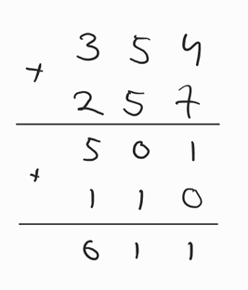
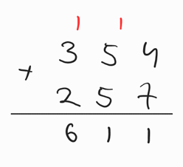
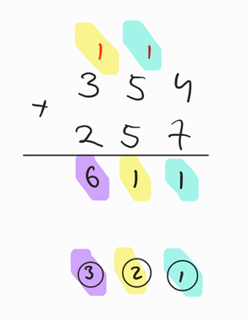
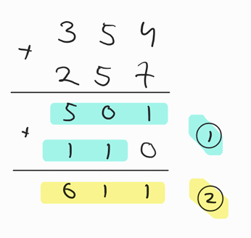
PPC Example
Serial calculation
Parallel calculation

Slide 4
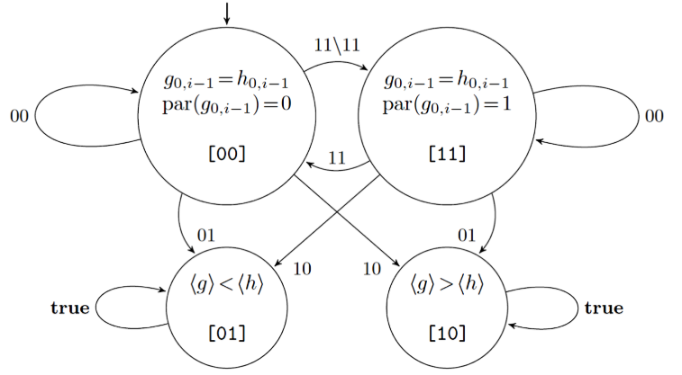
SM - Comparing (stable) RGC

Slide 5
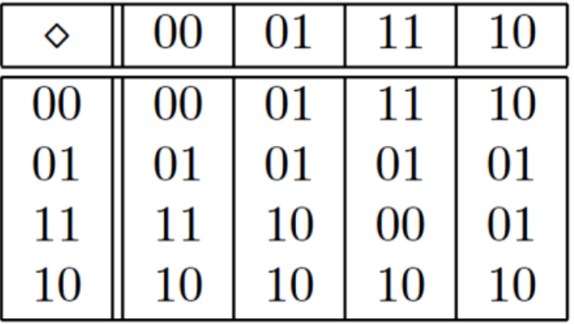
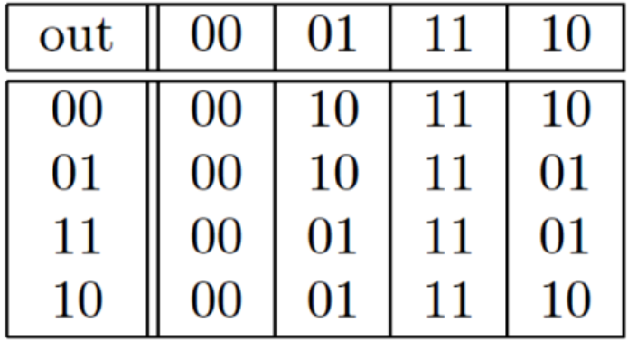
SM - Comparing (stable) RGC
Dimond Function
Output Function

Slide 6
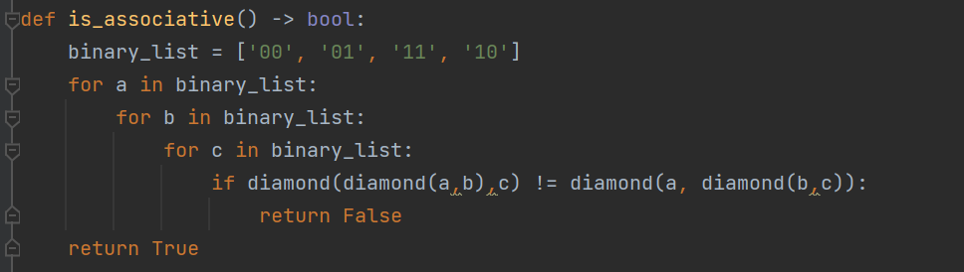
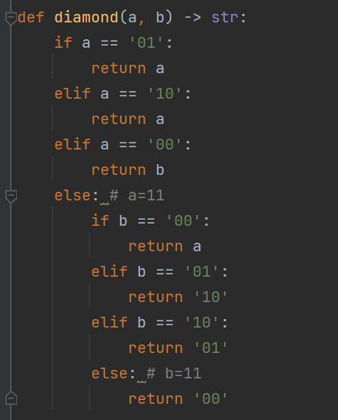

Is the Diamond function associative?
Yes!

Slide 7
Using associativity
Given that the function is associative we will want to operate the parentheses in a way that will serve our purpose.
Instead of using them like this:
$$s_{7:0}={(((((((s}_{0}∗s_{1})∗s_{2})∗s_{3})∗s_{4})∗s_{5})∗s_{6})∗s_{7})$$
We can use them as follows:
$$s_{7:0}={(((s}_{0}∗s_{1})∗(s_{2}∗s_{3}))∗{((s}_{4}∗s_{5})∗(s_{6}∗s_{7})))$$

Slide 8











PPC 8b String
X_0 | X_1 | X_2 | X_3 | X_4 | x_5 | X_6 | X_7
$$S_{7:6}$$
$$S_{5:4}$$
$$S_{3:2}$$
$$S_{1:0}$$
$$S_{7:4}$$
$$S_{3:0}$$
$$S_{7:0}$$
$$S_{5:0}$$
$$S_{6:0}$$
$$S_{4:0}$$
$$S_{2:0}$$
$$π_{0}$$ | $$π_{1}$$ | $$π_{2}$$ | $$π_{3}$$ | $$π_{4}$$ | $$π_{5}$$ | $$π_{6}$$ | $$π_{7}$$

Slide 9


PPC 8b String
X_1 | X_2 | X_3 | X_4 | x_5 | X_6 | X_7 | X_8
X_1 | X_2 | X_3 | X_4
X_1 | X_2
L0
L1
PPC-4bits
PPC-2bits
L2
L4
L3
$$π_{1}$$ | $$π_{2}$$ | $$π_{3}$$ | $$π_{4}$$ | $$π_{5}$$ | $$π_{6}$$ | $$π_{7}$$ | $$π_{8}$$
$$π_{1}$$ | $$π_{2}$$ | $$π_{3}$$ | $$π_{4}$$
$$π_{1}$$ | $$π_{2}$$
[Ladner & Fischer]

Slide 10
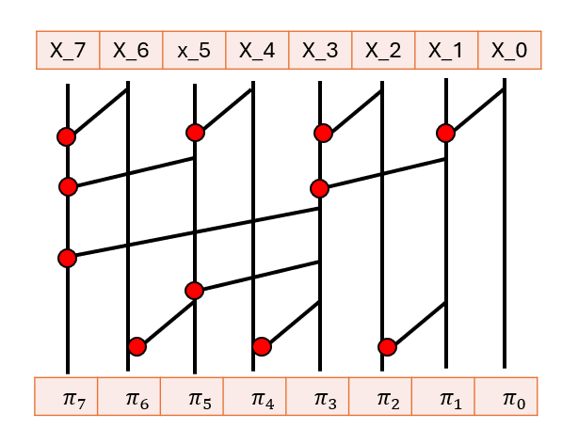
PPC - Comparing (stable) RGC
Dimond Function
PPC Module
Output Function
Final States
{Max(g,h),Min(g,h)}

Slide 11
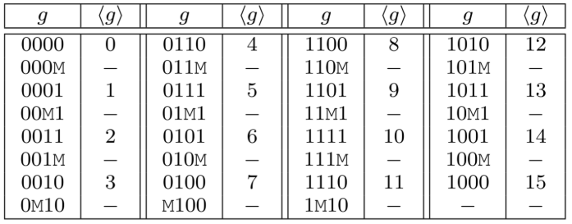
MC - Comparing RGC
What happens in a state machine when a metastable signal is received?
Can the state machine be in two decisive states at the same time?

Slide 12
Is the MC-Diamond function associative?
No!
So why does it work?
Because the associativity is preserved over the valid sequences in the Gray code!

Slide 13
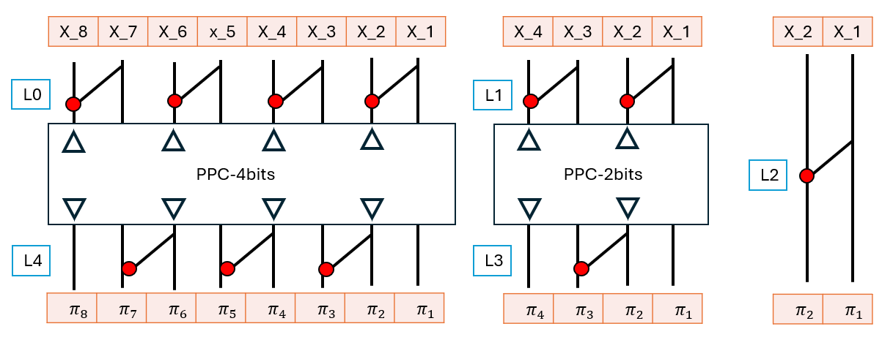
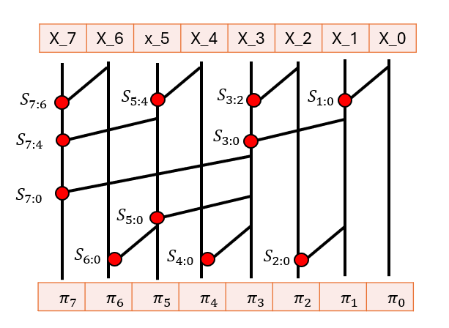
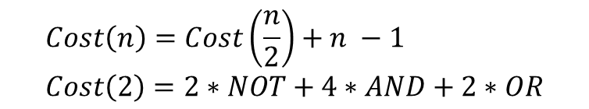


PPC - Cost & Delay
$$Cost\left(n\right)=Cost\left(\frac{n}{2}\right)+n −1 \\ Cost\left(2\right)=2∗NOT+4∗AND+2∗OR$$
$$Delay\left(n\right)=log⁡(n)$$
The last bit that stabilizes is in the n-1st place.

Slide 14
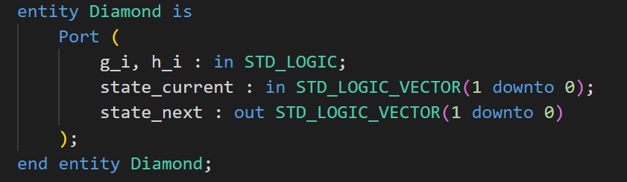
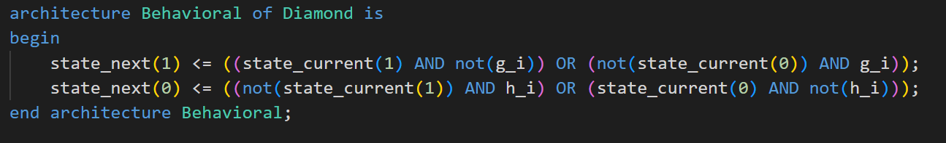
Implementation – Diamond Function

Slide 15
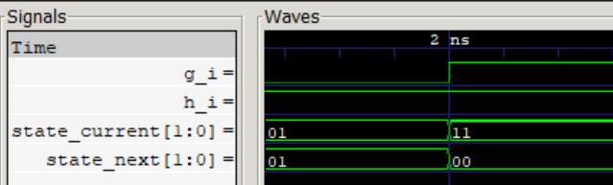
Implementation – Diamond Function

Slide 16
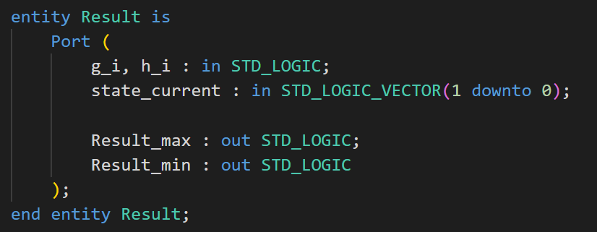
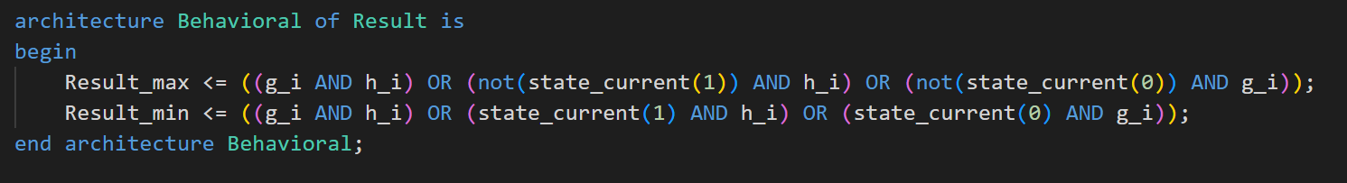
Implementation – Output Function

Slide 17
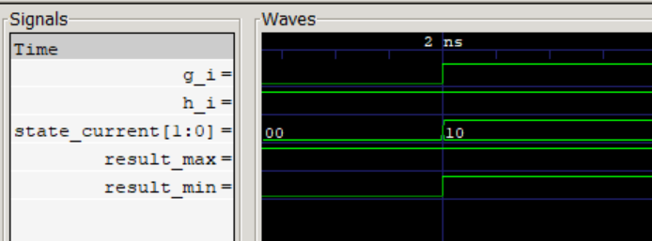
Implementation – Output Function

Slide 18
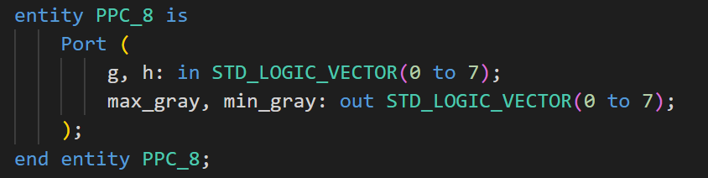
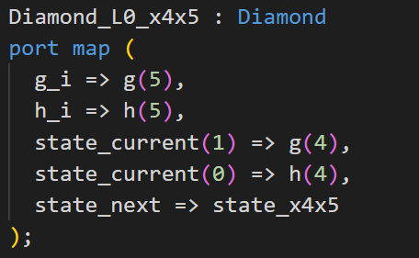
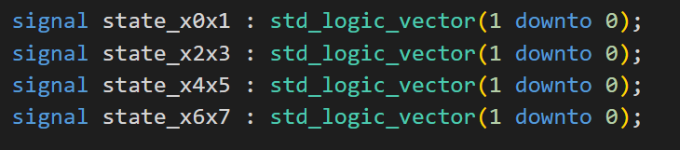
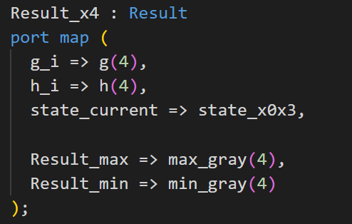
Implementation – PPC 8b

Slide 19
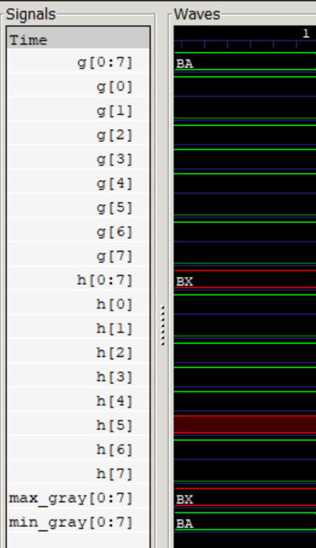
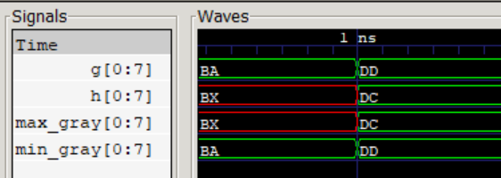


Implementation – PPC 8b
$$211<211.5$$
$$150<151$$

Slide 20
List of attachments
PPC_8.vhdl
PPC_8_tb.vhdl
Diamond.vhdl
Diamond_tb.vhdl
Result.vhdl
Result_tb.vhdl
Associative_fv.py

